Slide 1
Video Compression

Slide 2
Why does video compression work ?
JPEG compression exploits the spatial redundancy in image data through DCT
For video data, each frame can be compressed using JPEG and a compression ratio of 20:1 can be achieved. Can it be do more ?
Consecutive frames are very similar. If we encode the first frame and encode where each region moves to in the second frame, we obtain a prediction of the second frame. Only the residual needs to be encoded.
This is similar to predictive coding that exploits the temporal redundancy in video data

Slide 3
MPEG compression
Motion Picture Expert Group, established in 1990 to create standards for delivering audio and video data
MPEG-1: for VHS quality video (VCD, 320 x 240 pixels/frame or audio of 1.5 Mbits/sec). The components of MPEG1 are
  JPEG+motion prediction for video coding
  MUSICAM based audio
  Stream control
MPEG-2: designed for various bitrates from 352x240 consumer video (4Mbit/s), 720x480 studio TV(15 Mbit/s), to HDTV 1440x1152 (60 Mbit/s)

Slide 4
Motion Prediction
Suppose the first frame is encoded already using JPEG, what is the best way of encode frame 2 ?
  JPEG
  Motion prediction
Motion prediction
Frame 1
Frame 2

Slide 5
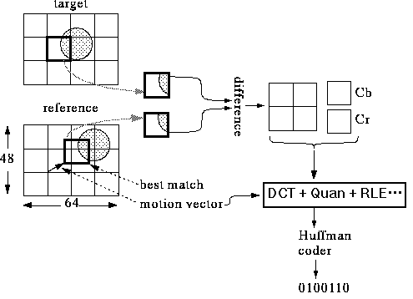
Motion prediction
For motion prediction to work, we need to record the motion of every pixel. This can be done more efficiently using image blocks called “Macroblocks”
The predicted macroblock and the actual image block are compared and the difference is encoded

Slide 6
Motion prediction
Previous frame is called “reference” frame
Current frame is called “target” frame
The target frame is divided into 16x16 macroblocks
For each macroblock, its best match in the reference frame is computed, the 2D motion vector and the image prediction error are recorded
  Prediction error: DCT+Quantization+RLE+Huffman
  Motion vector: Quantization+entropy coding

Slide 7
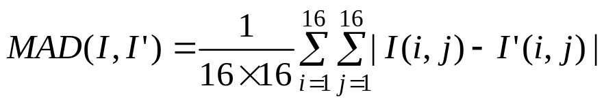
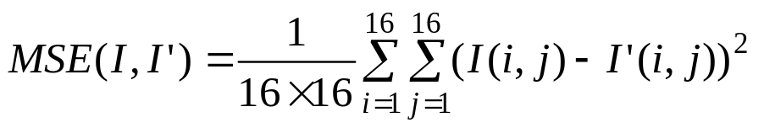
Matching Macroblocks
Different match measures and methods can be used for finding the best match for each macroblock
Different measures
  Mean absolute difference
  Mean squared difference

Slide 8
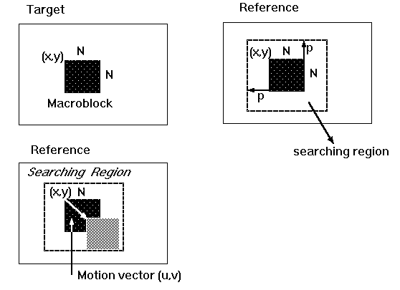
Matching Macroblocks
Different matching methods
  Full search method - search the RxR regions to find the position with minimum MAD or MSE

Slide 9
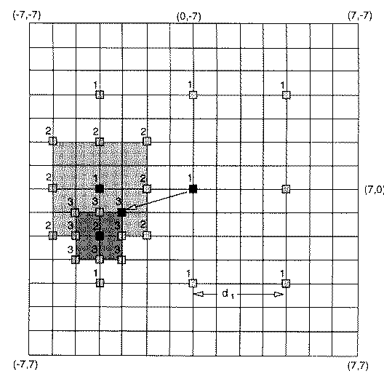
Matching Macroblocks
Two-dimensional logarithmic search
  Search at the largest scale at nine locations
  Find the best match
  Start from the best match, reduce the scale, repeat the previous steps

Slide 10
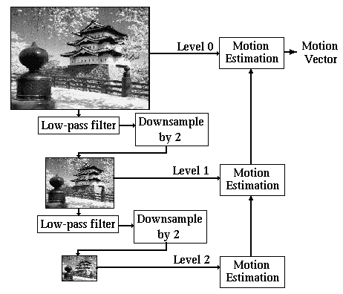
Matching Macroblocks
Hierarchical motion estimation
  Build image pyramid by down-sampling the image
  Estimate the motion at the coarse level
  Propagate the motion from the coarse level to the next fine level
  Refine the motion at fine level
  Repeat these steps until the finest level

Slide 11
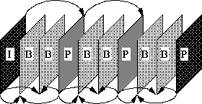
MPEG compression
MPEG encodes video frames using the following pattern
I-frame: Intraframe
P-frame: Interframe
B-frame: Bi-directional frame, search for macroblocks both in I-frame and P-frame
So B frames are decoded after next P frame is decoded

Slide 12
Why B frame ?
Images in video are best predicted by both previous and following images, especially for occluded areas
In frame 2, the black region can not be predicted from frame 1, because it is not visible in frame 1
But it can be inferred from frame 3
Frame 1
Frame 2
Frame 3

Slide 13
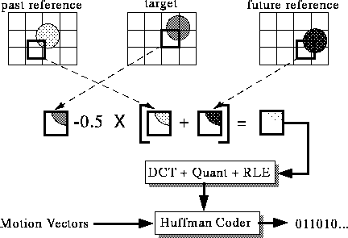
B-frame encoding

Slide 14
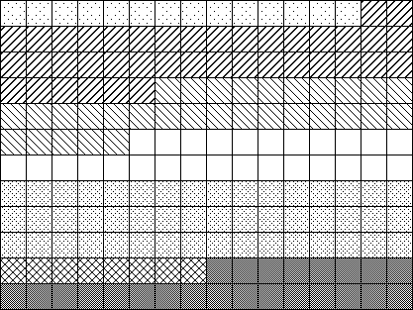
Slices
To make the process of decoding more resilient to transmission errors, each frame is divided into slices. If one slice is corrupted, the decode will restart from the beginning of the next slice. The following image is divided into 7 slices

Slide 15
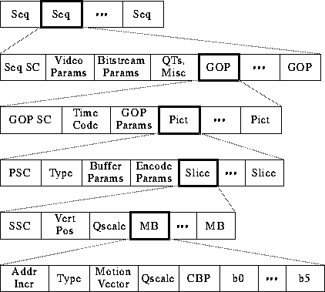
MPEG video bitstream

Slide 16
MPEG video bitstream
Sequence information
  Video Params include width, height, aspect ratio of pixels, picture rate.
  Bitstream Params are bit rate, buffer size, and constrained parameters flag (means bitstream can be decoded by most hardware)
  Two types of QTs: one for intra-coded blocks (I-frames) and one for inter-coded blocks (P-frames).
Group of Picture (GOP)Information
  Time code: bit field with SMPTE time code (hours, minutes, seconds, frame).
  GOP Params are bits describing structure of GOP.

Slide 17
MPEG video bitstream
Picture information
  Type: I, P, or B-frame?
  Buffer Params indicate how full decoder's buffer should be before starting decode.
  Encode Params indicate whether half pixel motion vectors are used.
Slice information
  Vert Pos: what line does this slice start on?
  QScale: How is the quantization table scaled in this slice?
Macroblock information
  Addr Incr: number of MBs to skip.
  Type: Does this MB use a motion vector? What type?
  QScale: How is the quantization table scaled in this MB?
  Coded Block Pattern (CBP): bitmap indicating which blocks are coded.

